Slide 1

Algorithmic Trading Strategy for BTC-USD Market Zelta Labs (Mid-Prep)

Slide 2

A bit about Bitcoin Market
Bitcoin Overview:
Launched: 2009 by Satoshi Nakamoto.
Nature: Decentralized digital currency with no central authority.
Blockchain Technology: Secure, transparent, and immutable transactions.
Why Bitcoin is Important:
Market Leader: Largest cryptocurrency by market capitalization.
High Volatility: Known for significant price swings, offering trading opportunities.
Growing Adoption: Institutional investors, hedge funds, and retail traders participate actively.
BTC/USDT Pair:
Liquidity: BTC/USDT is the most traded cryptocurrency pair due to USDT’s stable value.
Volatility: Offers great potential for short- and long-term trading strategies.

Slide 3
Introduction to Algorithmic Trading
Algorithmic trading involves the use of computer programs to automatically execute trades based on predetermined rules and market data. These algorithms analyze price, volume, and time to optimize trade execution and reduce human error.
BTC/USDT Pair:
High Liquidity: Most traded stablecoin-crypto pair.
Volatility: Offers numerous trading opportunities.
24/7 Market: Always open, ideal for automated strategies.

Slide 4


Trading Strategy Overview

Slide 5

Technical Indicators Implemented
We initially implemented over 50 technical indicators to identify which ones best fit our model for maximizing profits while minimizing risk. Using heat maps of correlation coefficients, we analyzed each pair of indicators within a particular category to determine their effectiveness.
Trend Following
Momentum Following
Volume Following
Volatility Following

Slide 6

Trend Following Indicators
These indicators help us to identify overall market direction in which the market is heading into.
Advantages:
Captures Large Price Movements
Reduces Emotional Trading
Disadvantages:
Lag in Entry and Exit
Can trigger false signals in sideways markets

Slide 7
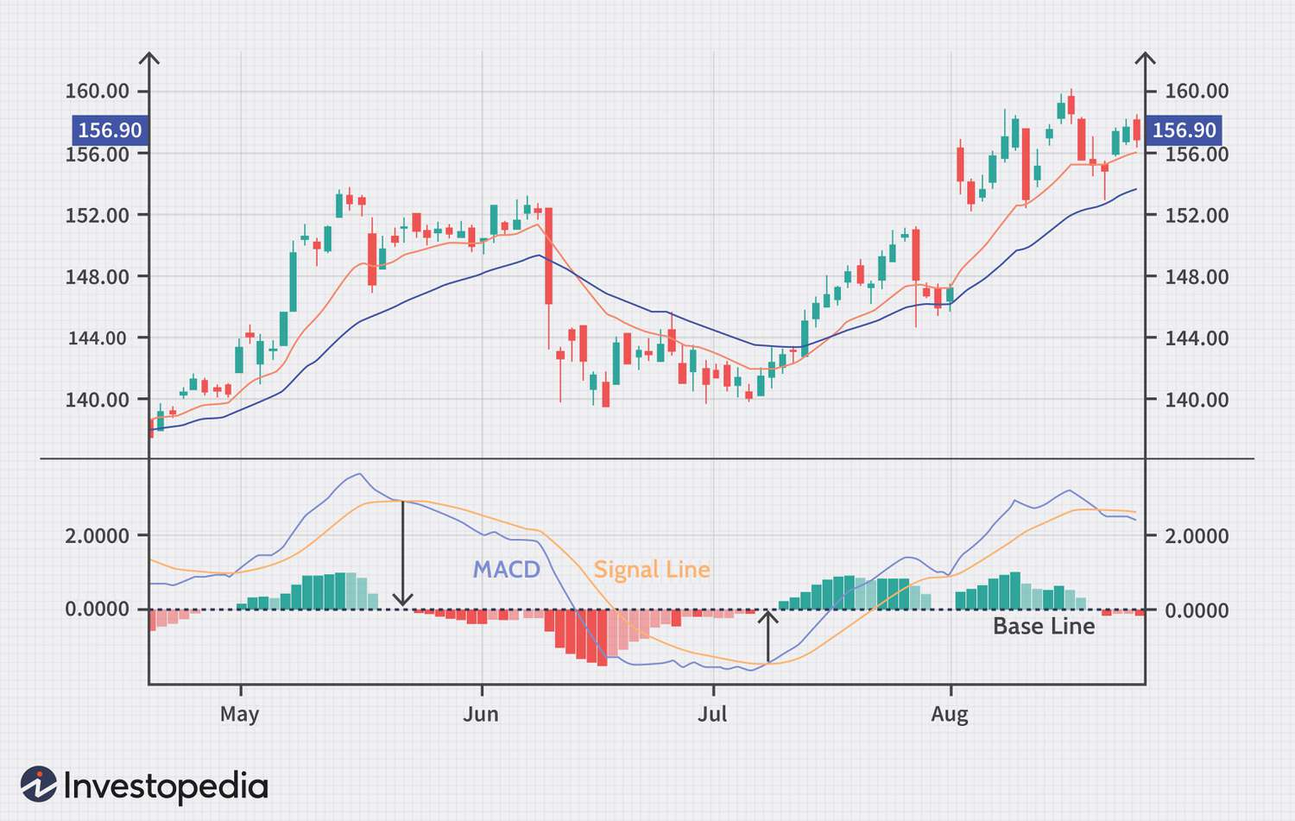
MACD Graph

Slide 8
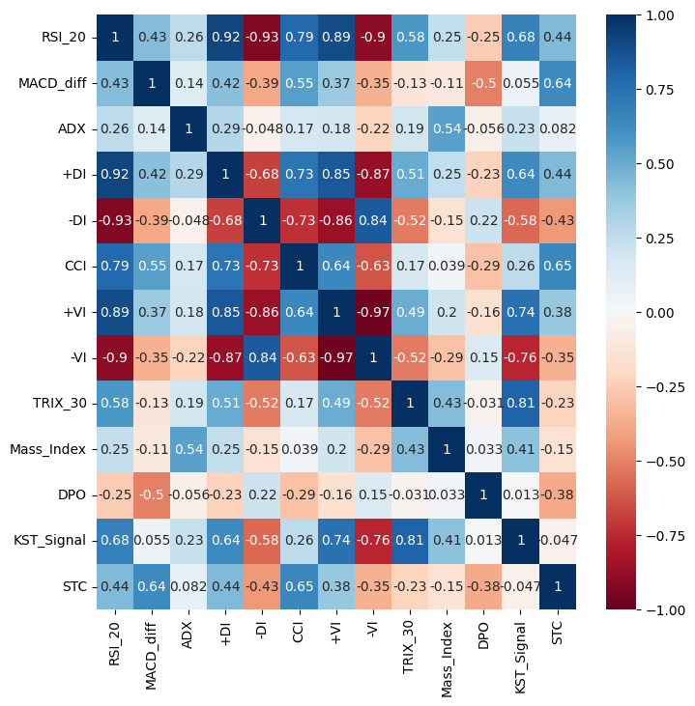
Trend Following Heat Map

Slide 9
Trend Following Shortlisted Indicators
Moving Average Convergence Divergence (MACD)
Average Directional Movement Index (ADX)
Trix (TRIX)
Mass Index (MI)
Detrended Price Oscillator (DPO)
Schaff Trend Cycle (STC)

Slide 10

Momentum Indicator
These indicators help us understand if a trend is gaining or losing strength hinting towards overbought or oversold conditions.
Advantages:
Detects Early Trend Reversals
Overbought/Oversold Signals
Disadvantages:
1. False Signals in Volatile Conditions
2. Limited in Sideways Markets

Slide 11
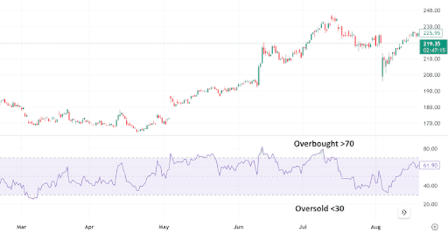
Relative Strength Index

Slide 12
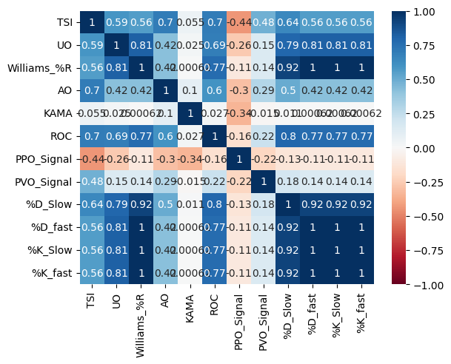
Momentum Indicators Heat Map

Slide 13
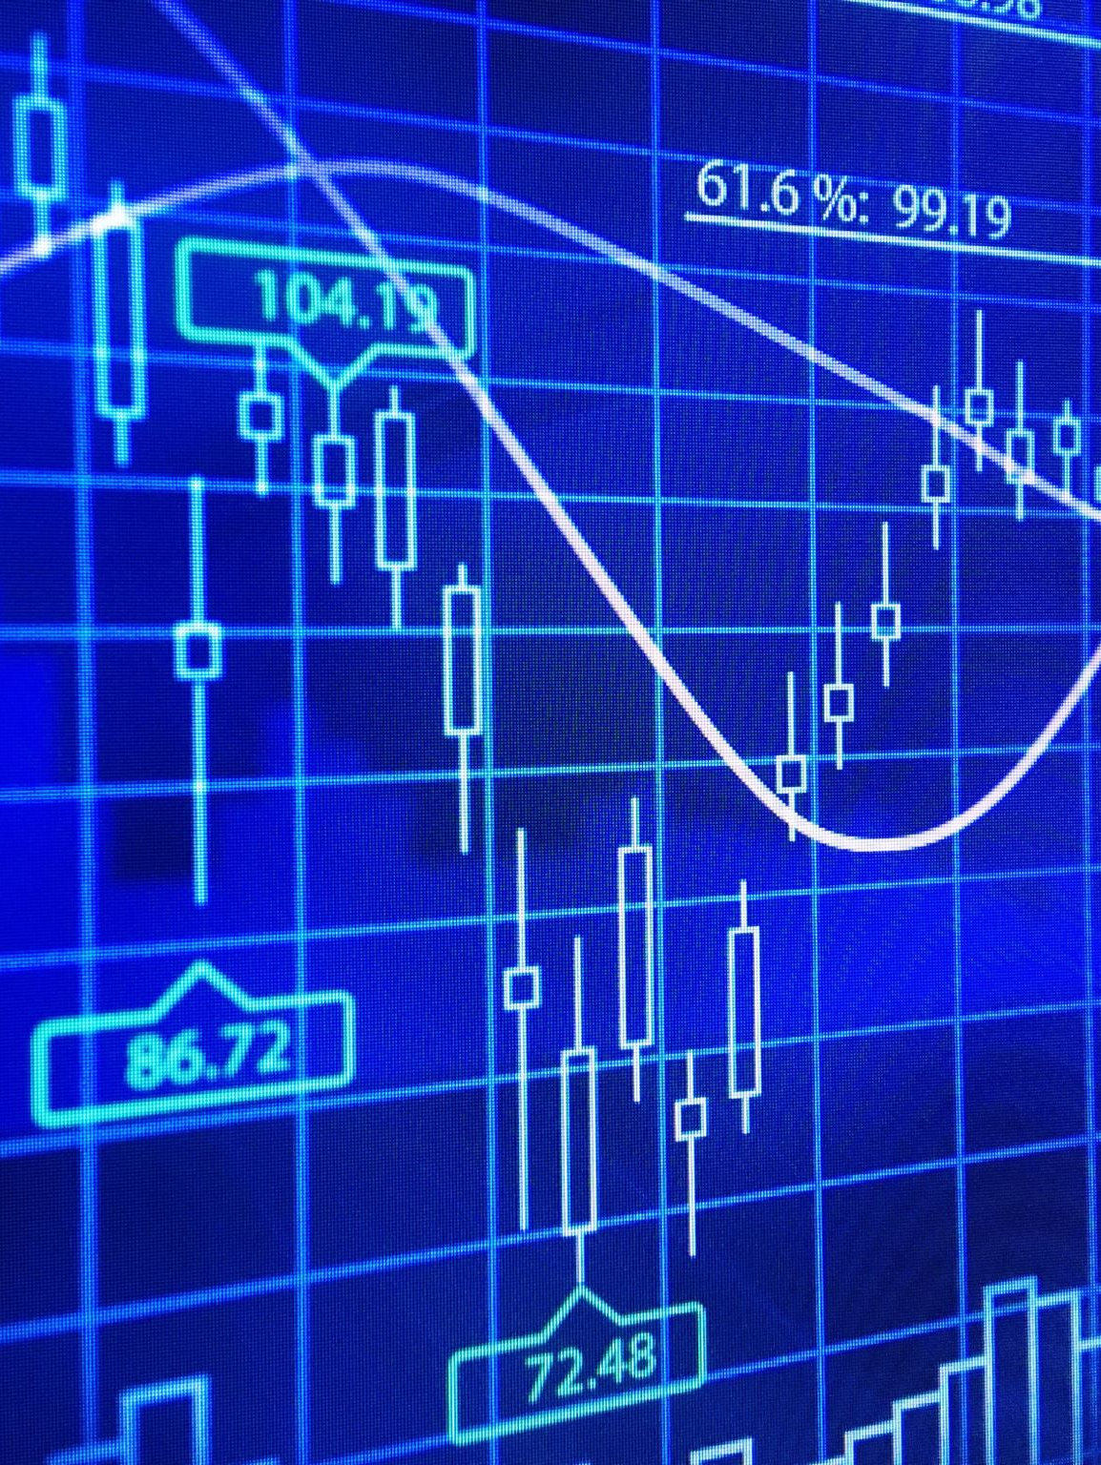
Momentum Shortlisted Indicators
Relative Strength Index (RSI)
True strength index (TSI)
Ultimate Oscillator (UO)
Awesome Oscillator (AO)
Percentage Price Oscillator (PPO)
Percentage Volume Oscillator (PVO)

Slide 14

Volume Following Indicators
These indicators measure the volume of trading happening on the asset over a certain period.
Advantages:
Confirms Price Movements
Identifies Breakouts
Disadvantages:
Volume Spikes Can Signal Market Manipulation
Delayed Signals

Slide 15
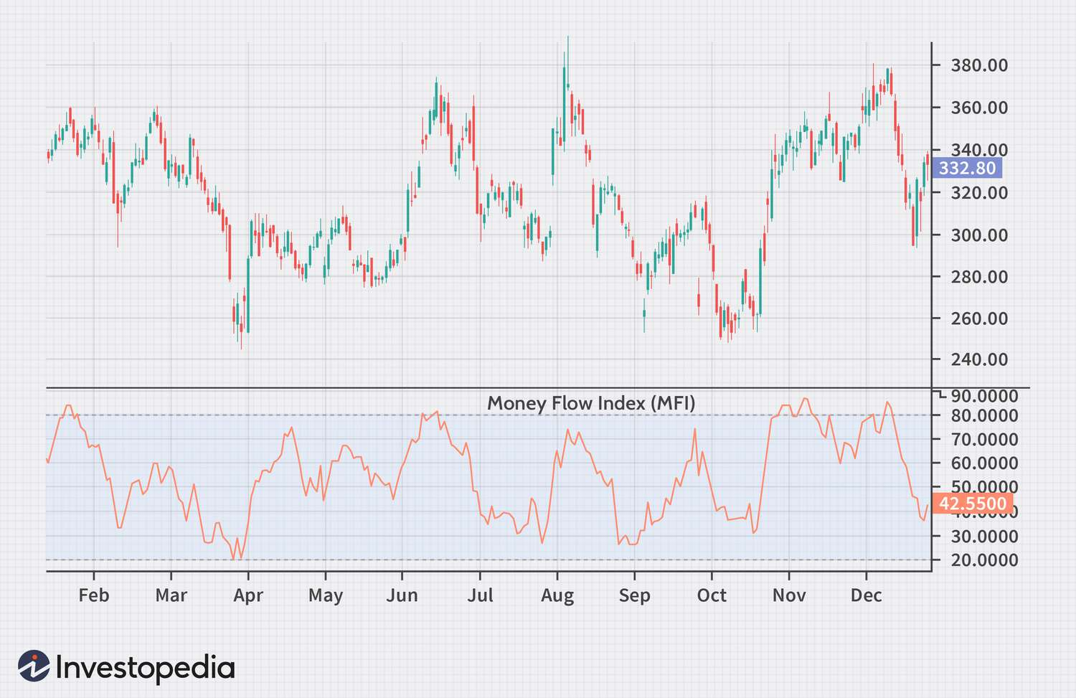
Money Flow Index Graph

Slide 16
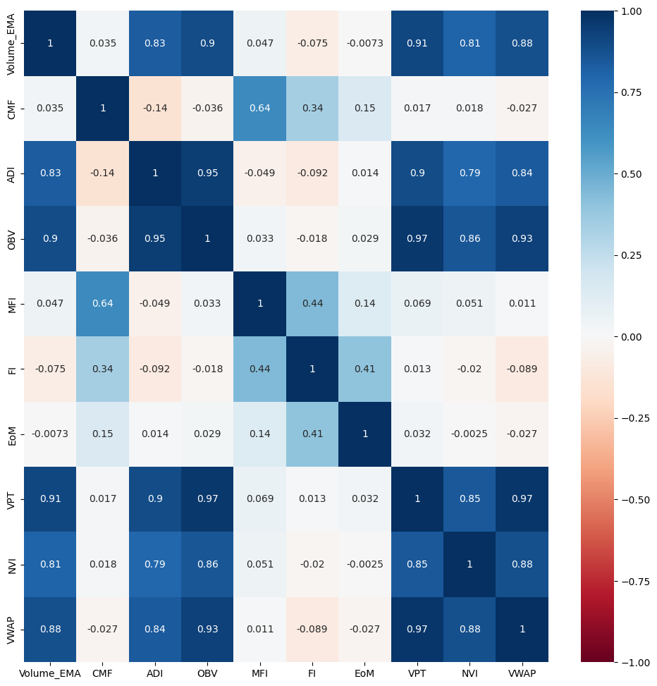
Volume Following Indicators Heat Map

Slide 17

Volume Following Shortlisted Indicators
Money Flow Index (MFI)
Chaikin Money Flow (CMF)
Force Index (FI)
Ease of Movement (EoM, EMV)

Slide 18
Volatility Indicators
These indicators measure the degree of price fluctuations on an asset over a specific period.
Ulcer Index
Coefficient of Variance
Advantages:
Risk Assessment
Identifies Breakout Opportunities
Disadvantages:
False Signals in Low Volatility
Difficult to Interpret Entry or Exit Positions Effectively

Slide 19
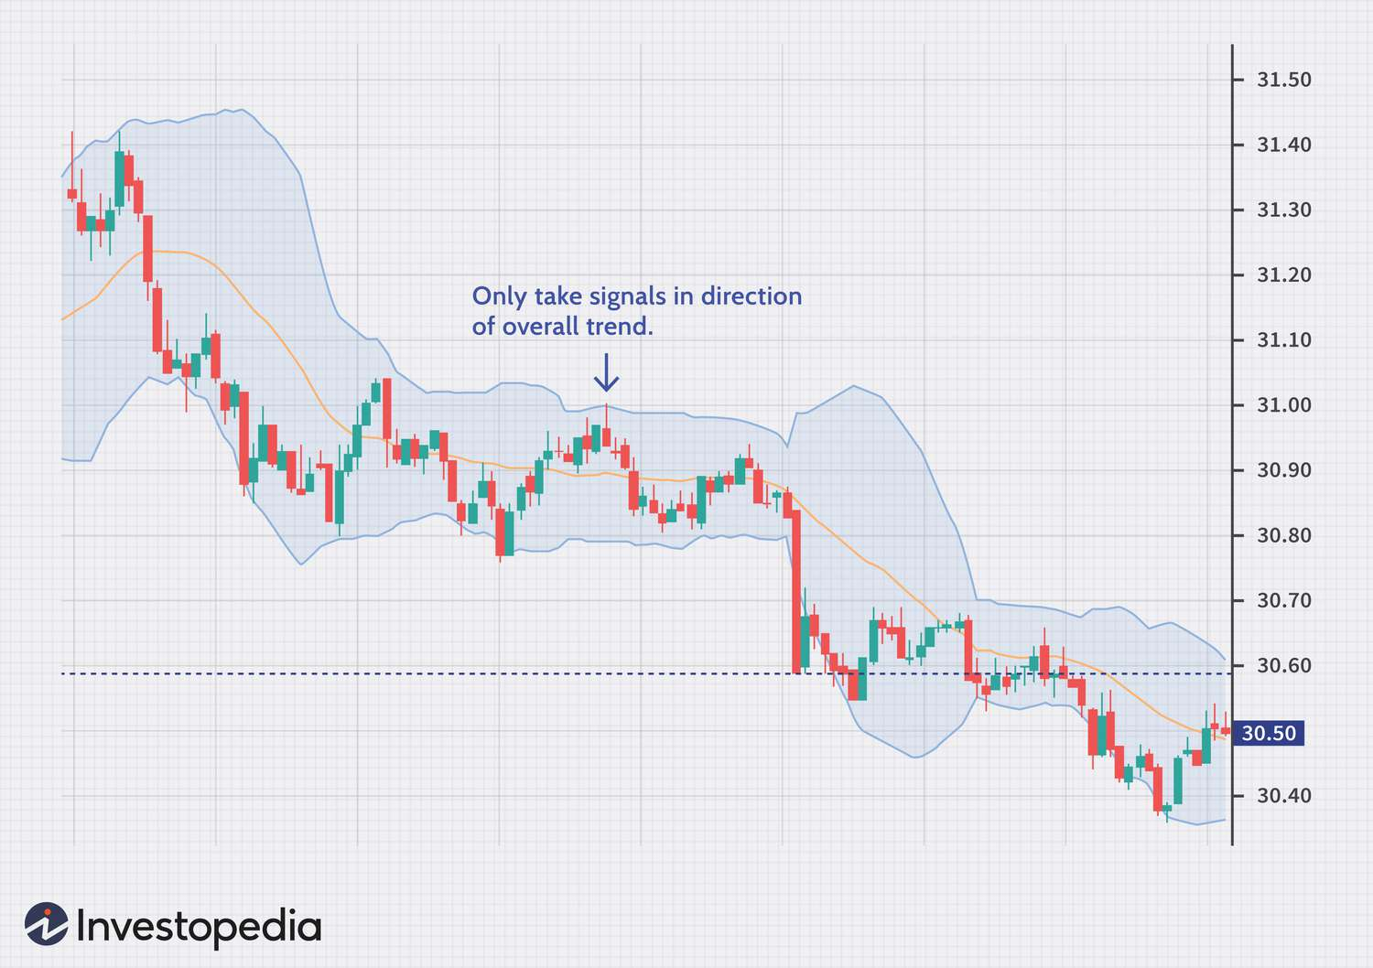
Bollinger Bands

Slide 20
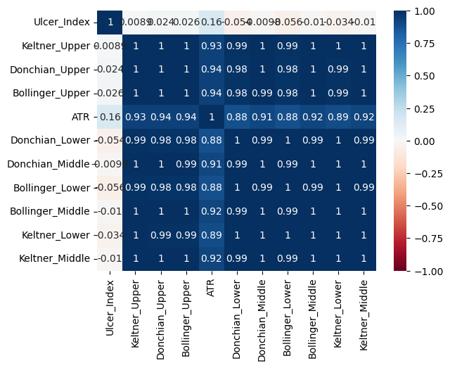
Volatility Indicators Heat Map

Slide 21
How to set target value for model
Here we have used the indicators as the features for the machine learning model .
The target value is either 0 or 1 depending on whether next day's returns are negative / positive respectively.

Slide 22
IMPLEMENTATION OF XGBOOST MODEL
Xgboost is a boosted tree strategy which uses an ensemble of improved trees to make predictions.
There are two types of XGBoost models -
1.XGBClassifier - We use this for classification task. Here we choose one of the two trade calls i.e short or long and hence the classifier model is used.
2.XGBRegressor - We use this for regression task . Here we predict a value based on the features . We will use this in the later part to minimize maximum drawdown and realted risk.

Slide 23
How do Boosted Tree Models work?
Decision tree:The model creates various splits at each node depending on factors like the information gain i.e how much imbalance of classes does a split decrease.
Random forest- It is an upgraded version of the decision tree which uses sampling by replacement to create multiple trees and then takes an ensemble of these trees based on amount of say.
XGBoost : It is a type of random forest model which constantly improves the decision trees in the ensemble to optimize the ensemble .

Slide 24
Hyper-parameter Tuning
XGBoost has various hyper-parameters which needs to configured externally by the programmer . These specify the structure of each tree , the ensemble size , the sampling size , the learning rate and regularization coefficients to avoid overfitting.
We have used BayesSearchCV for hyperparameter tuning , which tunes based on distribution of the hyperparameter and selects the values that optimizes the results in the best manner.

Slide 25
Rationale for Strategy Selection
We have used this strategy for a variety of purposes including -
XGboost is very efficient in dealing with missing values.
XGboost has innate hyperparameters to deal with overfitting.
XGBoost is very efficient in finding both linear and non-linear relationships in the data and can effectively model something as complex as the cryptocurrency markets.
The long-short strategy is more efficient (yet riskier) since we can earn returns on each day unlike a long- only strategy.

Slide 26
Backtesting Overview
Testing Period: 1 Jan 2023 to 14 Oct 2024
Data Used: 1 day BTC/USDT price data
This data includes price(Open, High, Low, Close), Volume and Market Cap(Valuation)
XGBoost model has made significant gains on backtesting data despite overfitting the train set . This is common and is expected of an efficient method such as XGBoost.

Slide 27
Backtesting Results
Annual Returns: 74%
Cumulative Returns: 320% over 649 days
Annualised Sharpe Ratio: 1.94
Win Ratio: 53% wins
Max Drawdown: 32%

Slide 28
Risk Management Approach
In the original model , the maximum drawdown is 32% which is repulsive for risk averse investor therefore we have devised an alternate approach for such investors using assuming that log-returns follow student t's distribution .
Here instead of choosing a pure long-short trade , investor chooses a long-short split which minimizes returns but also reduces related risk.

Slide 29
Student t's distribution
We have proved that a random sample of size 38 follows t-distribution more closely than normal distribution
The p_value is the ratio of the number of random samples of optimal sample size( found using ks test) that follows t-distribution more closely than normal distribution .
P_value=0.94 for our data.

Slide 30
We use an XGBoost regressor model with tuned hyperparameter , with indicators as features and the next day's returns as target.
Such a model outputs a value instead of a trade call , based on this value we make a long-short split investment .
We divided the predicted log-returns value with the probability distribution function , the logic of which is explained in the report.
Such an approach will punish abnormal predicted results since there corresponding pdf will be smaller and hence the product lower.
We input this in the sigmoid function with w=5 (chosen by taking various other values)

Slide 31
Making Predictions and trade calls
Sigmoid(x)= 1/1+e^wx
Such a model will not make any call when expected returns(x) =0 since model in invariant and sigmoid gives a 0.5 value i.e equal split between long and short
On other values on expected returns(x) we get a long-short split and we compute results based on the returns of this split

Slide 32
Conclusion
The strategy developed for the BTC/USDT market offers a robust and balanced approach leveraging the volatility and liquidity of Bitcoin. By combining various technical indicators and incorporating risk management practices, this strategy is well-suited for the dynamic and fast-paced nature of cryptocurrency markets.

Slide 33
Thank You!

